Slide 1
Waitakere BMX Club 2.4 (Practice task)
(Your name)

Slide 2
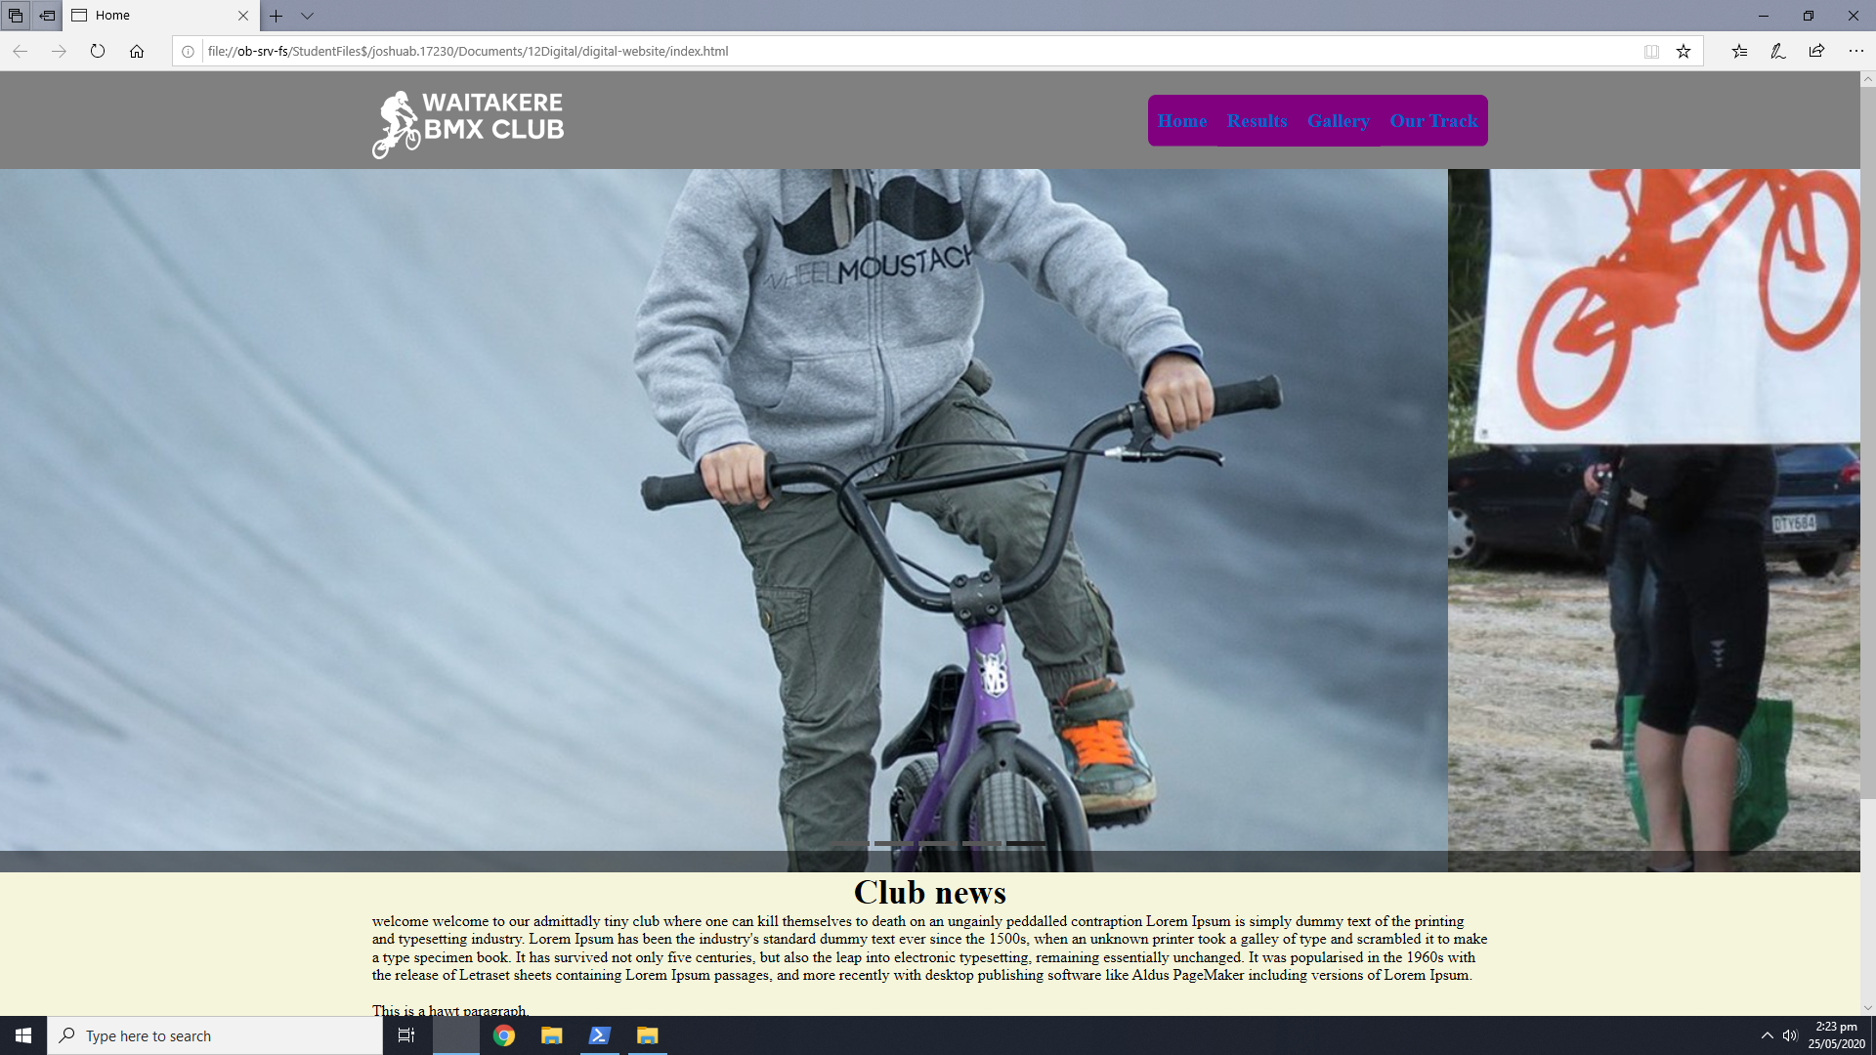
Feedback
Nav bar is pretty hard to read and a little small, the purple doesn’t match with the other colours, the image slider is too wide
The photo is quite messy and that you can’t really see the image. Change the colour so it is easier to read

Slide 3
Relevant Implication
Aesthetics. My website will incorporate all the shiny flashy stuff that I can reasonably include and in a manner that does not distract the user from the object at hand, which is the glorification of the wonderful Waikato motor polo club.
Notes:
Identify and explain 3 relevant implications that you will focus on during the creation of your project

Slide 4
Relevant Implication
Legal
I’m gonna do this website legally by not copy and pasteing all of my code from some poor guys website. Also, credit where credit is due, the pictures are gonna be given.
Also, free software forever.
Notes:
Identify and explain 3 relevant implications that you will focus on during the creation of your project

Slide 5
Relevant Implication
Ease of access. There will be no <marquee> tags in the website making it retardedly difficult to use.
Notes:
Identify and explain 3 relevant implications that you will focus on during the creation of your project

Slide 6
Step 1 : Empathize

Slide 7
Task 1 : Identify your client and the purpose of your website, who is your target audience?
The client I will be developing a website for is Waitakere BMX Club, I have been asked by the president to design a new, modern looking site that will attract more users to site to promote the club.
The target audience of this site is our local community, other BMXers from around New Zealand. Aged from 5 – 50.
Notes:
Check out their current site so you can see why they want a new design
https://www.waitakerebmx.com/

Slide 8
Step 2 : Define

Slide 9
What are your client’s specifications?
The site must be modern
Clean and simple layout
Use of bright colours
Professional looking
Promote the club
4 pages
Image slider on the home page showing recent photographs

Slide 10
The site will have lots of whitespace to be modern. This will ensure that the

Slide 11
Website Structure
index.html
our_track.html
gallery.html
results.html

Slide 12
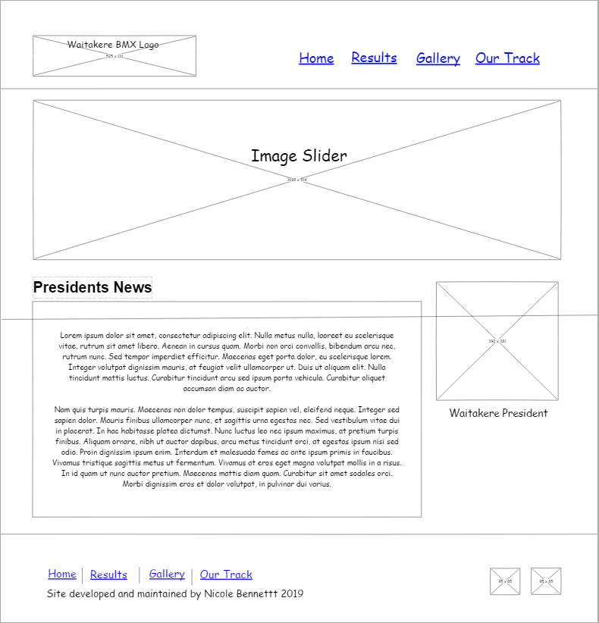
Low fidelity mock up of the home page

Slide 13
Image compression
Notes:
Save images to an appropriate name folder
Compress / edit images where need be
Name the files accurately e.g home_mainimage.jpeg suzanne_collins_closeup.jpeg rather than 249784sflkjfnjksfxn3r8.jpeg
Record this process

Slide 14
Step 3 : Ideate

Slide 15
Colour palette
Notes:
Generate 3 colour options for your client, keeping in mind he wants a clean layout (white background with a pop of colour)
https://www.canva.com/learn/100-color-combinations/

Slide 16
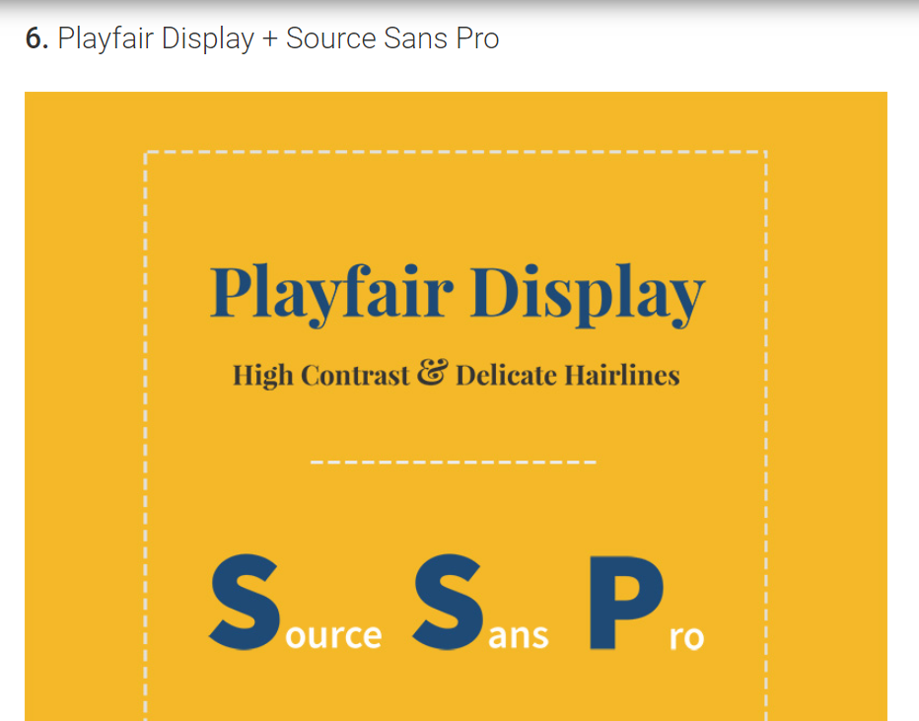
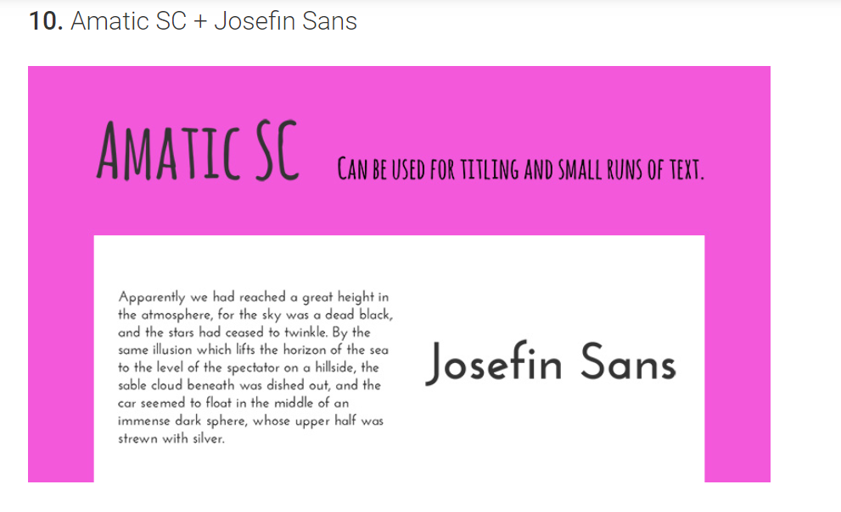
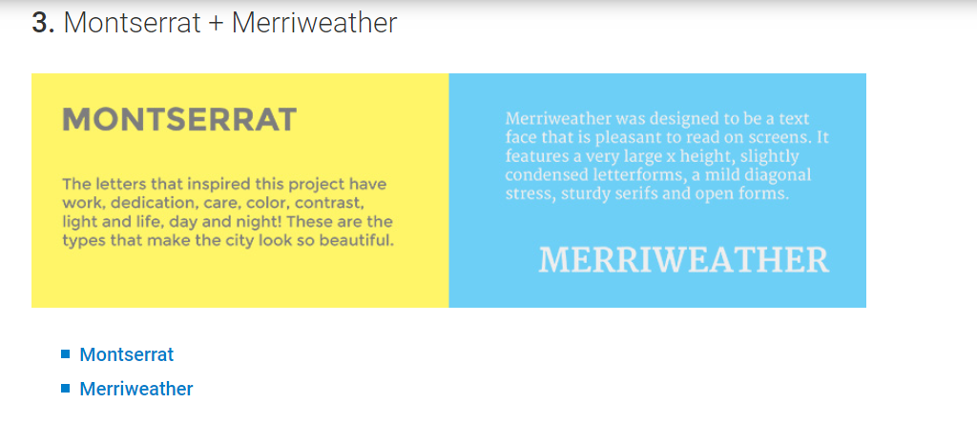
Font Combinations
Notes:
https://howtogetonline.com/best-google-font-combinations-currently-trending.php
Select 3 different font options that you wish to present to your client and trial when you are coding

Slide 17
Step 4 : Protype/ Testing

Slide 18
Site setup
Notes:
Screenshot your folder in Dreamweaver showing that your files are named correctly(lower case and underscores)

Slide 19
A vs B testing (colours)
Notes:
Trial

Slide 20
A vs B testing (fonts)
Notes:
Trial

Slide 21
Feedback from client / stakeholders
Notes:
Screenshot your home page and seek written feedback from end users
What changes do you need to make and why? Do you need to carry out further research or give more colour/font options etc/

Slide 22
Cross browser testing
Notes:
Test your site on mobile, tablet and pc view AND in different browsers

Slide 23
Testing Procedures: Validating the HTML/CSS
Notes:
Validate your HTML/CSS3 website – screenshot the no errors.

Slide 24
Explain how your final design addressed the relevant implications

Slide 25
Addressing relevant implication : Usability
S
E
X
A
A relevant implication that I focussed on during the creation of my website was usability. Usability is the process of making my site easy for my end users to navigate. I wanted to present my information and photography in a minimalistic way so that a wide range of people could access my site. For example, I made sure that I used the colour ??? For my hover effect on my main navigation bar, this gave clear contrast allowing users to instantly recognize their location on the nav bar. Furthermore, I had a footer with secondary hyperlinks so that the user wouldn’t have to scroll to the top unnecessarily. When trialling my site, some of my end users thought that my font in the nav bar was too small, therefore I changed the font to 120% to make it easier to read, especially for people who wear glasses etc. My target audience is young people to older people across NZ who have an interest in BMX. My site also uses media queries to ensure that it scales across different devices so that it can be accessed on phones and different monitor sizes.

Slide 27
Addressing relevant implication :

